Slide 1
Mohammed-Raise/MEASURING-THE-PULSE-OF-PROSPERITY-AN-INDEX-OF-ECONOMIC-FREEDOM-ANALYSIS
SlideMake.com

Slide 2

Introduction to the Index of Economic Freedom
The index measures the degree of economic freedom in different countries worldwide.
It provides insights into how government policies influence economic prosperity.
Understanding this index helps policymakers and investors make informed decisions.
Notes:
Image source: https://www.slidemake.com

Slide 3
Background and Purpose of the Index
Developed to assess the impact of economic policies on overall prosperity.
Aims to promote policies that enhance individual freedom and economic growth.
Serves as a benchmark for evaluating economic reforms and policy effectiveness.
Notes:
Image source: https://www.slidemake.com

Slide 4
Methodology and Data Sources
Combines multiple indicators related to business, trade, fiscal policy, and regulation.
Uses data collected from international organizations and economic surveys.
Scores countries on a scale from 0 to 100, with higher scores indicating more economic freedom.
Notes:
Image source: https://www.slidemake.com

Slide 5
Components of the Index
The index is divided into several categories, including Rule of Law and Regulatory Efficiency.
Each category assesses specific aspects like property rights and government size.
These components collectively determine the overall freedom score of a country.
Notes:
Image source: https://www.slidemake.com

Slide 6
Significance of the Index for Prosperity
Higher levels of economic freedom are correlated with higher income levels and growth rates.
The index helps identify policies that foster entrepreneurship and investment.
It highlights the importance of institutional quality and economic stability.
Notes:
Image source: https://www.slidemake.com

Slide 7
Trends and Global Patterns
Recent data shows a gradual increase in global economic freedom.
Regions like Asia and Eastern Europe have experienced significant improvements.
Conversely, some nations face setbacks due to policy changes or geopolitical issues.
Notes:
Image source: https://www.slidemake.com

Slide 8
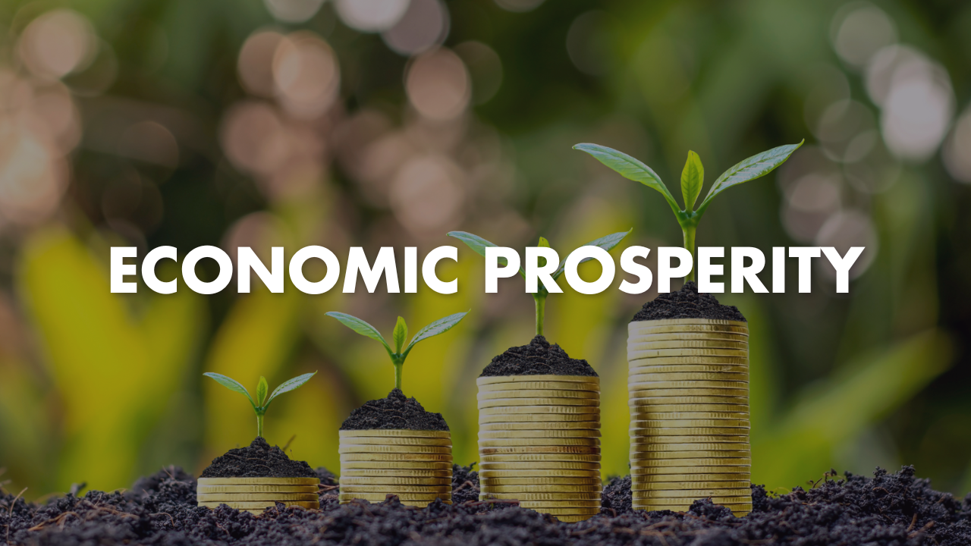
Case Studies and Country Rankings
Countries like Hong Kong and Singapore rank among the top for economic freedom.
Conversely, nations with strict regulations and heavy government control rank lower.
Analyzing these cases reveals best practices and challenges in policy implementation.
Notes:
Image source: https://www.actionsa.org.za

Slide 9
Criticisms and Limitations of the Index
Some critics argue that the index oversimplifies complex economic realities.
It may not fully capture informal economies or social factors.
Nevertheless, it remains a valuable tool for comparative analysis and policy formulation.
Notes:
Image source: https://www.slidemake.com

Slide 10
Policy Implications and Recommendations
Countries should focus on reducing regulatory barriers and improving property rights.
Encouraging transparency and reducing corruption can enhance economic freedom.
Continuous monitoring of the index helps track progress and inform reforms.
Notes:
Image source: https://www.slidemake.com

Slide 11
Conclusion and Future Directions
The index of economic freedom is essential for understanding prosperity and growth.
Ongoing improvements in measurement methods will provide more nuanced insights.
Promoting economic freedom remains a key goal for sustainable development worldwide.
Notes:
Image source: https://www.slidemake.com

Slide 12
References
Mohammed-Raise. "Measuring the Pulse of Prosperity: An Index of Economic Freedom Analysis."
Heritage Foundation. "2023 Index of Economic Freedom."
World Bank. "Doing Business Reports."

